Slide 1
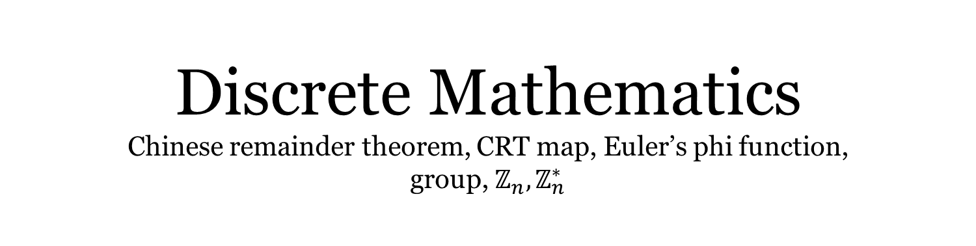
Discrete Mathematics Chinese remainder theorem, CRT map, Euler’s phi function, group, $ℤ_{n},ℤ_{n}^{∗}$
Liangfeng Zhang
School of Information Science and Technology
ShanghaiTech University

Slide 2

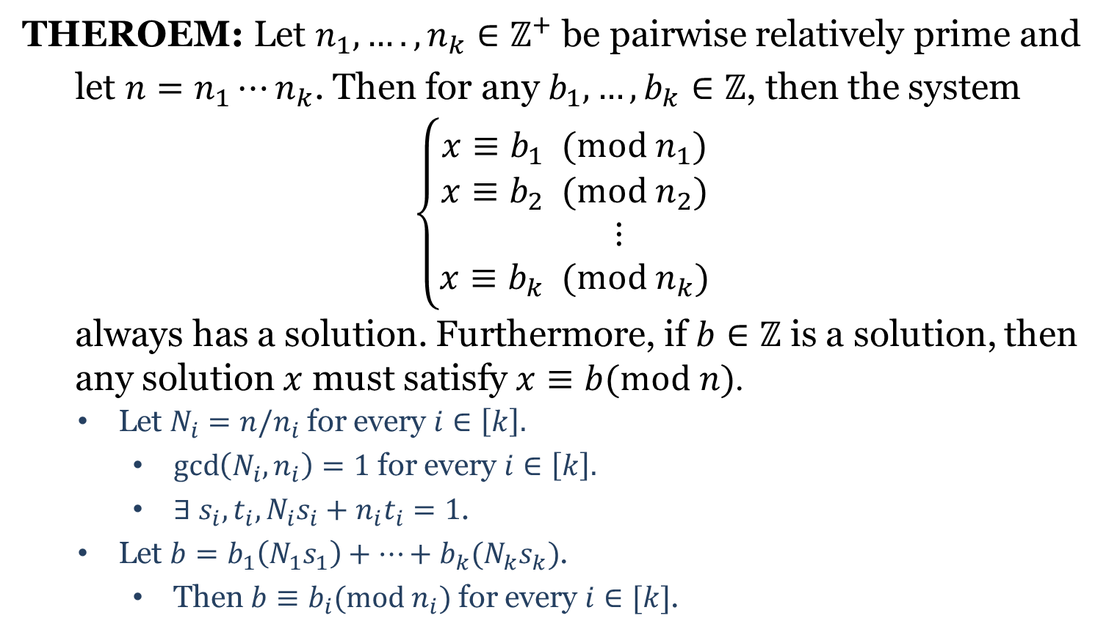
Chinese Remainder Theorem
THEROEM: Let $n_{1}, ….,n_{k}∈ℤ^{+}$ be pairwise relatively prime and
let $n=n_{1}⋯n_{k}$. Then for any $b_{1},…,b_{k}∈ℤ$, then the system
$$\left\{\begin{aligned}x≡b_{1} (mod n_{1}) \\ x≡b_{2} (mod n_{2}) \\ ⋮ \\ x≡b_{k} (mod n_{k})\end{aligned}\right.$$
always has a solution. Furthermore, if $b∈ℤ$ is a solution, then
any solution $x$ must satisfy $x≡b(mod n)$.
Let $N_{i}=n/n_{i}$ for every $i∈\left[k\right].$
$\gcd\left(N_{i},n_{i}\right)=1$ for every $i∈\left[k\right].$
$∃ s_{i}, t_{i}, N_{i}s_{i}+n_{i}t_{i}=1$.
Let $b=b_{1}\left(N_{1}s_{1}\right)+⋯+b_{k}(N_{k}s_{k})$.
Then $b≡b_{i}(mod n_{i})$ for every $i∈[k]$.
$x≡b_{i} \left(mod n_{i}\right)$ for all $i$
$⇒x≡b \left(mod n_{i}\right)$ for all $i$
$⇒n_{i}|(x−b)$ for all $i$
$⇒\left(n_{1}n_{2}⋯n_{k}\right)|(x−b)$
$⇒x≡b (mod n)$

Slide 3
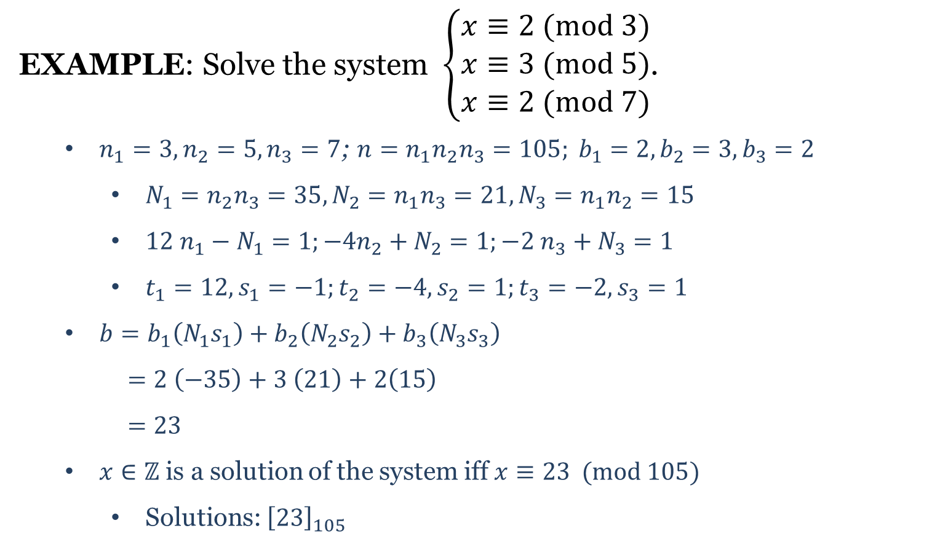
Solution to Sun-Tsu’s Question
EXAMPLE: Solve the system $\left\{\begin{aligned}x≡2 (mod 3) \\ x≡3 (mod 5) \\ x≡2 (mod 7)\end{aligned}\right.$.
$n_{1}=3, n_{2}=5, n_{3}=7$; $n=n_{1}n_{2}n_{3}=105; b_{1}=2, b_{2}=3, b_{3}=2$
$N_{1}=n_{2}n_{3}=35, N_{2}=n_{1}n_{3}=21, N_{3}=n_{1}n_{2}=15$
$12 n_{1}−N_{1}=1;−4n_{2}+N_{2}=1;−2 n_{3}+N_{3}=1$
$t_{1}=12, s_{1}=−1;t_{2}=−4, s_{2}=1;t_{3}=−2, s_{3}=1$
$b=b_{1}\left(N_{1}s_{1}\right)+b_{2}\left(N_{2}s_{2}\right)+b_{3}\left(N_{3}s_{3}\right)$
$=2 \left(−35\right)+3 \left(21\right)+2\left(15\right)$
$=23$
$x∈ℤ$ is a solution of the system iff $x≡23 (mod 105)$
Solutions: ${\left[23\right]}_{105}$

Slide 5
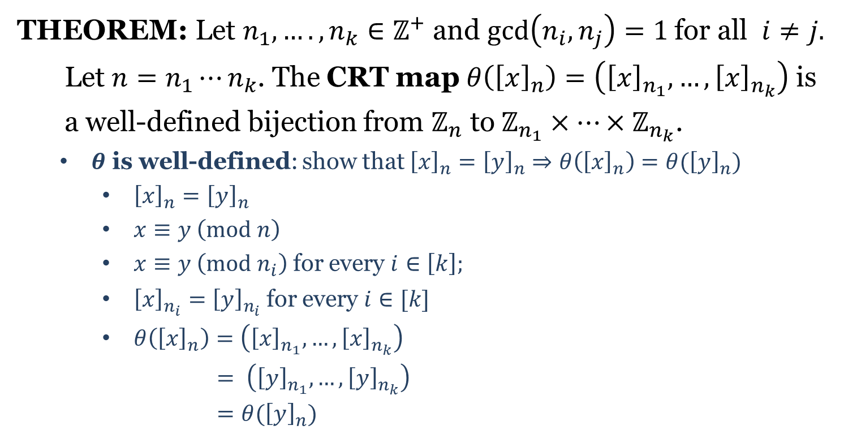
CRT Map
THEOREM: Let $n_{1}, ….,n_{k}∈ℤ^{+}$ and $\gcd\left(n_{i},n_{j}\right)=1$ for all $i≠j.$
Let $n=n_{1}⋯n_{k}$. The CRT map $θ\left({\left[x\right]}_{n}\right)=\left({\left[x\right]}_{n_{1}}, …,{\left[x\right]}_{n_{k}}\right)$ is
a well-defined bijection from $ℤ_{n}^{ }$ to$ℤ_{n_{1}}^{ }×⋯×ℤ_{n_{k}}^{ }$.
$θ$ is well-defined: show that ${\left[x\right]}_{n}={\left[y\right]}_{n}⇒θ\left({\left[x\right]}_{n}\right)=θ({\left[y\right]}_{n})$
${\left[x\right]}_{n}={\left[y\right]}_{n}$
$x≡y \left(mod n\right)$
$x≡y \left(mod n_{i}\right)$ for every $i∈\left[k\right];$
${\left[x\right]}_{n_{i}}={\left[y\right]}_{n_{i}}$ for every $i∈[k]$
$θ\left({\left[x\right]}_{n}\right)=\left({\left[x\right]}_{n_{1}},…, {\left[x\right]}_{n_{k}}\right)$
$= \left({\left[y\right]}_{n_{1}},…,{\left[y\right]}_{n_{k}}\right)$
$=θ({\left[y\right]}_{n})$

Slide 6
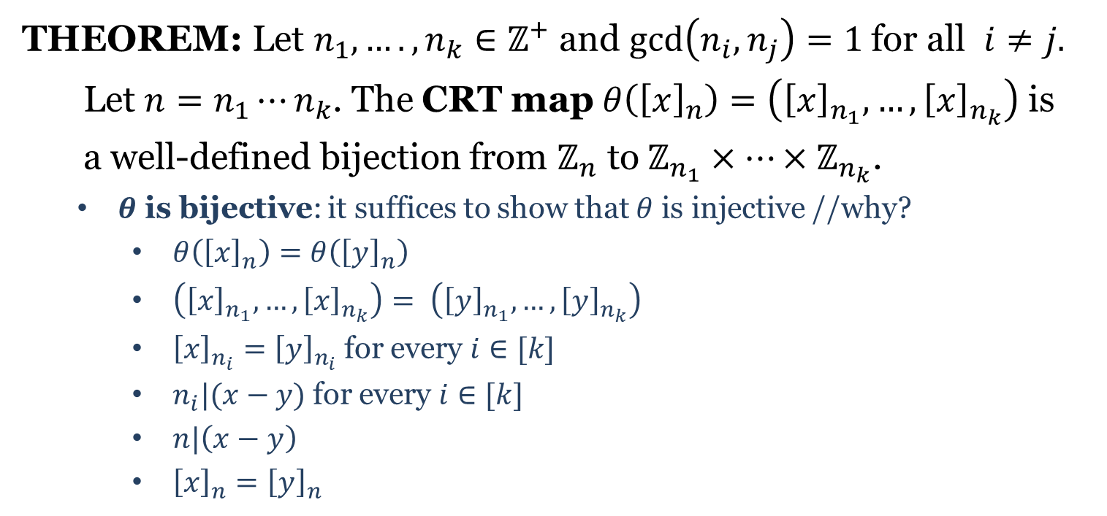
CRT Map
THEOREM: Let $n_{1}, ….,n_{k}∈ℤ^{+}$ and $\gcd\left(n_{i},n_{j}\right)=1$ for all $i≠j.$
Let $n=n_{1}⋯n_{k}$. The CRT map $θ\left({\left[x\right]}_{n}\right)=\left({\left[x\right]}_{n_{1}}, …,{\left[x\right]}_{n_{k}}\right)$ is
a well-defined bijection from $ℤ_{n}^{ }$ to$ℤ_{n_{1}}^{ }×⋯×ℤ_{n_{k}}^{ }$.
$θ$ is bijective: it suffices to show that $θ$ is injective //why?
$θ\left({\left[x\right]}_{n}\right)=θ\left({\left[y\right]}_{n}\right)$
$\left({\left[x\right]}_{n_{1}},…, {\left[x\right]}_{n_{k}}\right)= \left({\left[y\right]}_{n_{1}},…,{\left[y\right]}_{n_{k}}\right)$
${\left[x\right]}_{n_{i}}={\left[y\right]}_{n_{i}}$ for every $i∈[k]$
$n_{i}|(x−y)$ for every $i∈[k]$
$n|\left(x−y\right)$
${\left[x\right]}_{n}={\left[y\right]}_{n}$

Slide 7
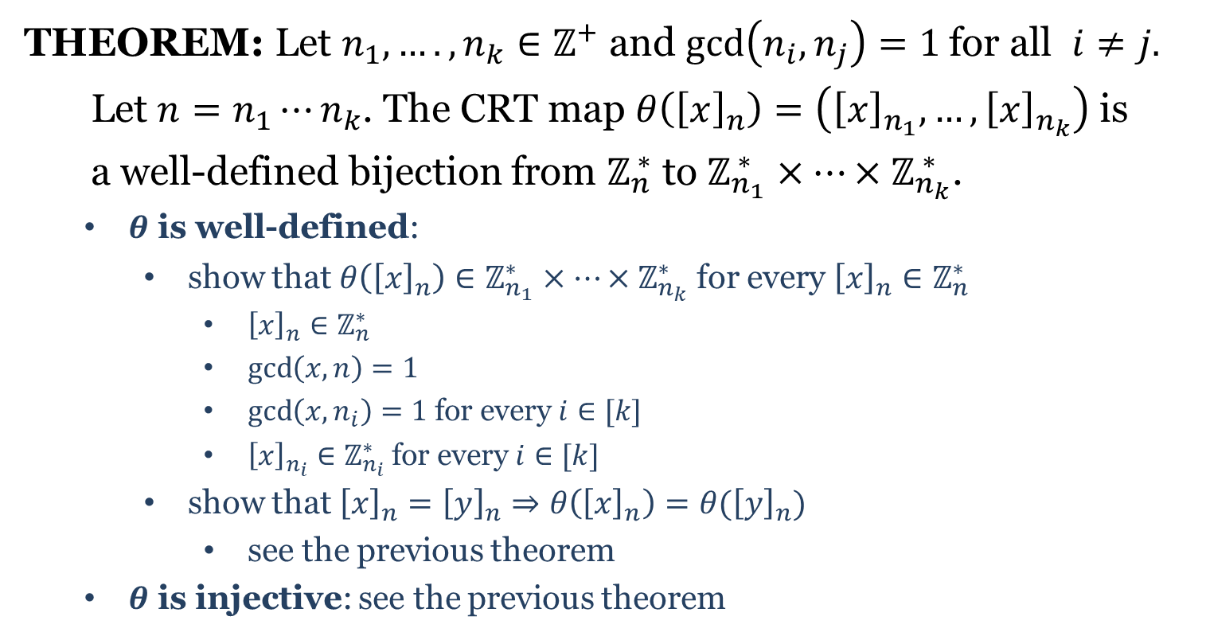
CRT Map
THEOREM: Let $n_{1}, ….,n_{k}∈ℤ^{+}$ and $\gcd\left(n_{i},n_{j}\right)=1$ for all $i≠j.$
Let $n=n_{1}⋯n_{k}$. The CRT map $θ\left({\left[x\right]}_{n}\right)=\left({\left[x\right]}_{n_{1}}, …,{\left[x\right]}_{n_{k}}\right)$ is
a well-defined bijection from $ℤ_{n}^{ ∗}$ to $ℤ_{n_{1}}^{ ∗}×⋯×ℤ_{n_{k}}^{ ∗}$.
$θ$ is well-defined:
show that $θ\left({\left[x\right]}_{n}\right)∈ℤ_{n_{1}}^{∗}×⋯×ℤ_{n_{k}}^{∗}$ for every ${\left[x\right]}_{n}∈ℤ_{n}^{∗}$
${\left[x\right]}_{n}∈ℤ_{n}^{∗}$
$\gcd\left(x,n\right)=1$
$\gcd\left(x,n_{i}\right)=1$ for every $i∈[k]$
${\left[x\right]}_{n_{i}}∈ℤ_{n_{i}}^{∗}$ for every $i∈[k]$
show that ${\left[x\right]}_{n}={\left[y\right]}_{n}⇒θ\left({\left[x\right]}_{n}\right)=θ({\left[y\right]}_{n})$
see the previous theorem
$θ$ is injective: see the previous theorem

Slide 8
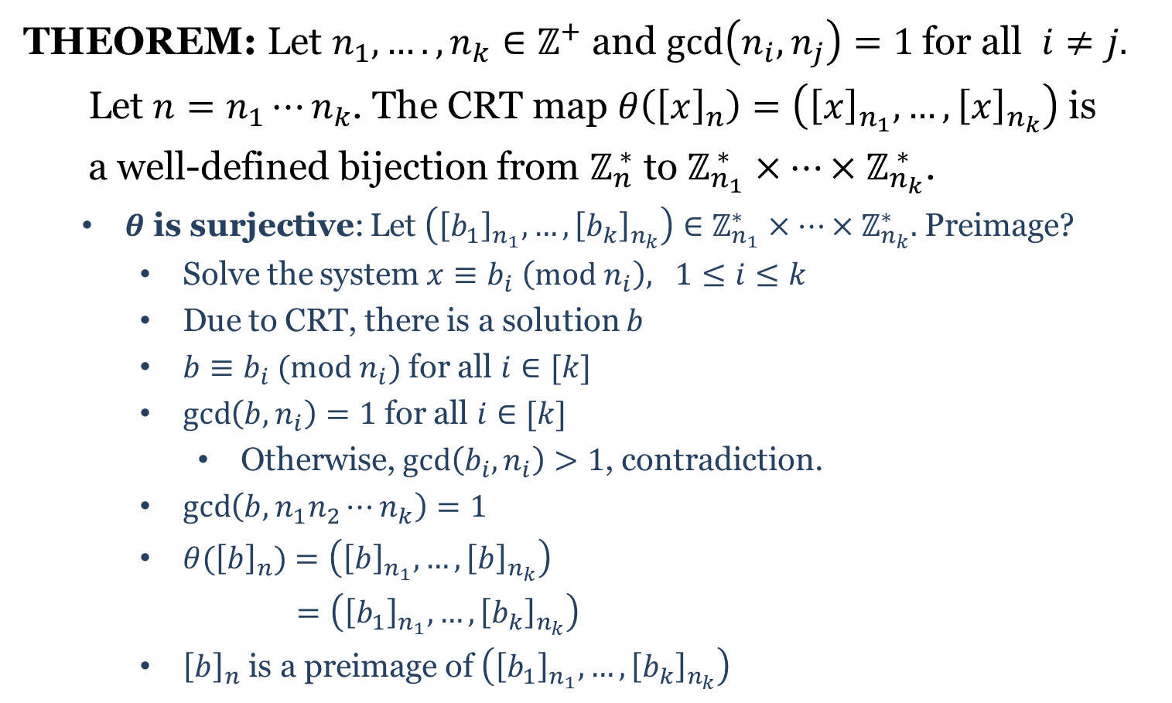
CRT Map
THEOREM: Let $n_{1}, ….,n_{k}∈ℤ^{+}$ and $\gcd\left(n_{i},n_{j}\right)=1$ for all $i≠j.$
Let $n=n_{1}⋯n_{k}$. The CRT map $θ\left({\left[x\right]}_{n}\right)=\left({\left[x\right]}_{n_{1}}, …,{\left[x\right]}_{n_{k}}\right)$ is
a well-defined bijection from $ℤ_{n}^{ ∗}$ to $ℤ_{n_{1}}^{ ∗}×⋯×ℤ_{n_{k}}^{ ∗}$.
$θ$ is surjective: Let $\left({\left[b_{1}\right]}_{n_{1}},…,{\left[b_{k}\right]}_{n_{k}}\right)∈ℤ_{n_{1}}^{∗}×⋯×ℤ_{n_{k}}^{∗}.$ Preimage?
Solve the system $x≡b_{i} \left(mod n_{i}\right), 1≤i≤k$
Due to CRT, there is a solution $b$
$b≡b_{i} (mod n_{i})$ for all $i∈[k]$
$\gcd\left(b,n_{i}\right)=1$ for all $i∈[k]$
Otherwise, $\gcd\left(b_{i},n_{i}\right)>1$, contradiction.
$\gcd\left(b,n_{1}n_{2}⋯n_{k}\right)=1$
${θ(\left[b\right]}_{n})=\left({\left[b\right]}_{n_{1}},…,{\left[b\right]}_{n_{k}}\right)$
$=\left({\left[b_{1}\right]}_{n_{1}},…,{\left[b_{k}\right]}_{n_{k}}\right)$
${\left[b\right]}_{n}$ is a preimage of $\left({\left[b_{1}\right]}_{n_{1}},…,{\left[b_{k}\right]}_{n_{k}}\right)$

Slide 9
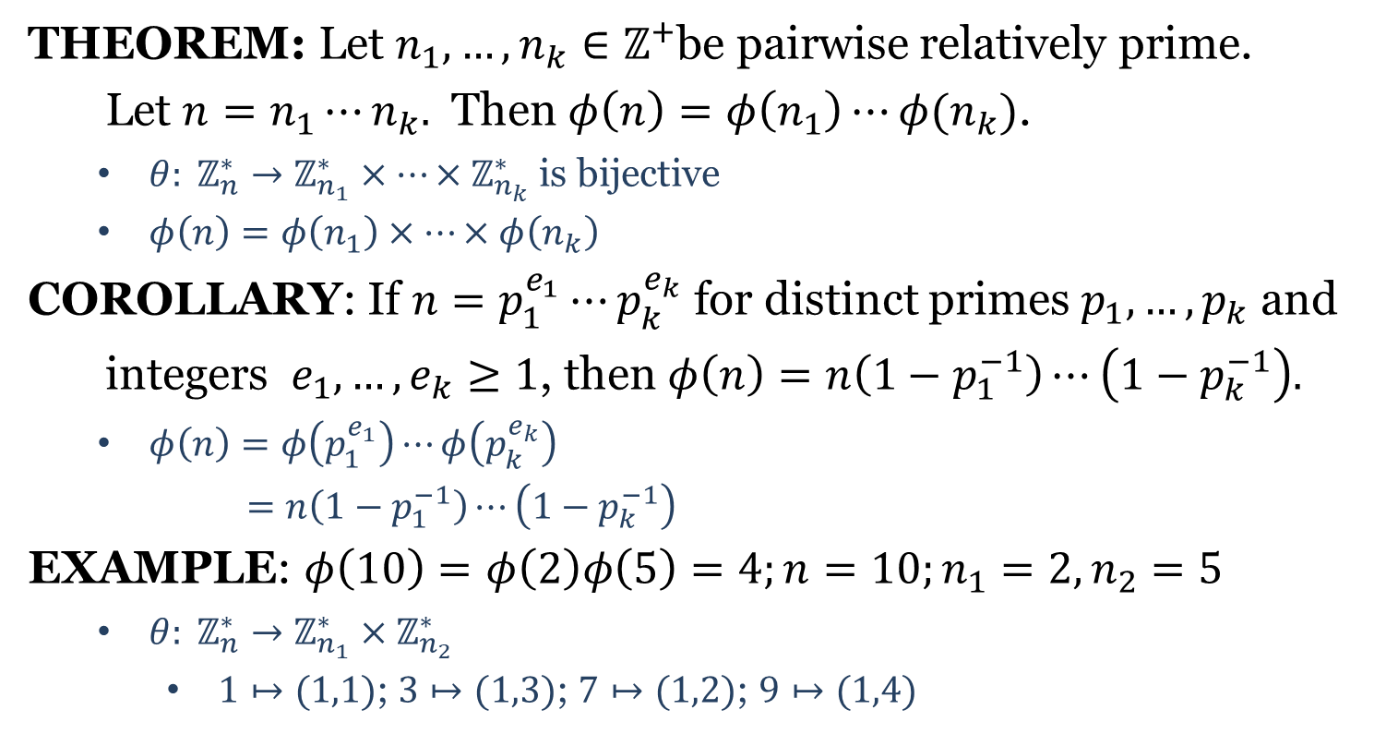
Euler’s Phi Function
THEOREM: Let $n_{1},…,n_{k}∈ℤ^{+}$be pairwise relatively prime.
Let $n=n_{1}⋯n_{k}.$ Then $φ\left(n\right)=φ\left(n_{1}\right)⋯φ(n_{k})$.
$θ: ℤ_{n}^{∗}→ℤ_{n_{1}}^{∗}×⋯×ℤ_{n_{k}}^{∗}$ is bijective
$φ\left(n\right)=φ\left(n_{1}\right)×⋯×φ\left(n_{k}\right)$
COROLLARY: If $n=p_{1}^{e_{1}}⋯p_{k}^{e_{k}}$ for distinct primes $p_{1},…,p_{k}$ and
integers $e_{1},…,e_{k}≥1$, then $φ\left(n\right)=n\left(1−p_{1}^{−1}\right)⋯\left(1−p_{k}^{−1}\right).$
$φ\left(n\right)=φ\left(p_{1}^{e_{1}}\right)⋯φ\left(p_{k}^{e_{k}}\right)$
$=n\left(1−p_{1}^{−1}\right)⋯\left(1−p_{k}^{−1}\right)$
EXAMPLE: $φ\left(10\right)=φ\left(2\right)φ\left(5\right)=4;n=10;n_{1}=2, n_{2}=5$
$θ: ℤ_{n}^{∗}→ℤ_{n_{1}}^{∗}×ℤ_{n_{2}}^{∗}$
$1↦(1,1)$; $3↦(1,3)$; $7↦(1,2)$; $9↦(1,4)$

Slide 11
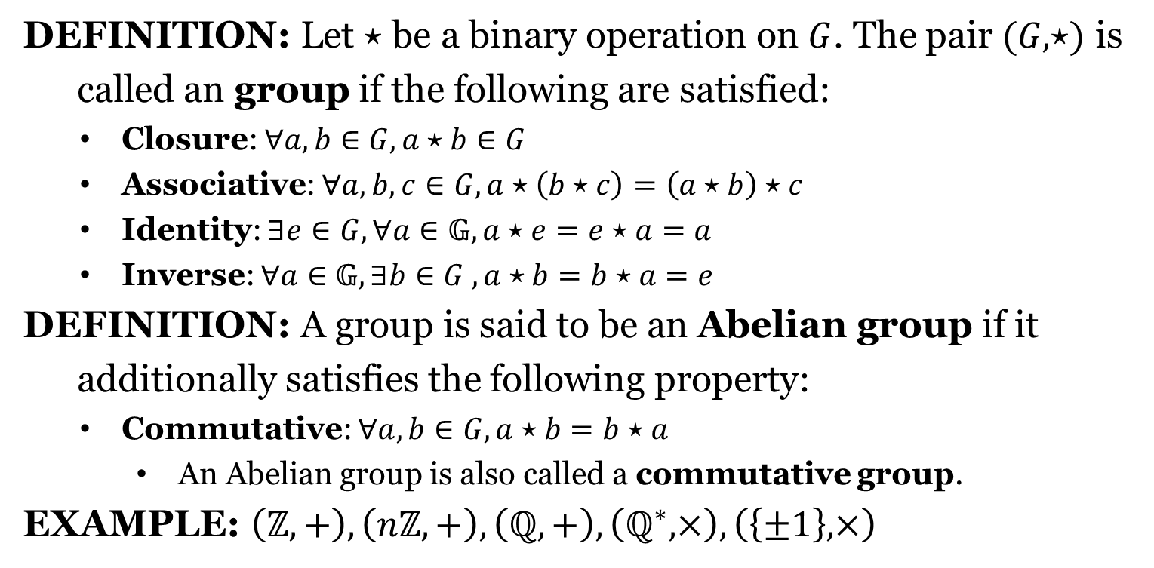
Group
DEFINITION: Let $⋆$ be a binary operation on $G$. The pair $(G,⋆)$ is
called an group if the following are satisfied:
Closure: $∀a,b∈G, a⋆b∈G$
Associative: $∀a,b,c∈G, a⋆\left(b⋆c\right)=\left(a⋆b\right)⋆c$
Identity: $∃e∈G, ∀a∈𝔾, a⋆e=e⋆a=a$
Inverse: $∀a∈𝔾, ∃b∈G , a⋆b=b⋆a=e$
DEFINITION: A group is said to be an Abelian group if it
additionally satisfies the following property:
Commutative: $∀a,b∈G, a⋆b=b⋆a$
An Abelian group is also called a commutative group.
EXAMPLE: $\left(ℤ,+\right), \left(nℤ, +\right), \left(ℚ,+\right), \left(ℚ^{∗}, ×\right),\left(\left\{±1\right\}, ×\right)$

Slide 12
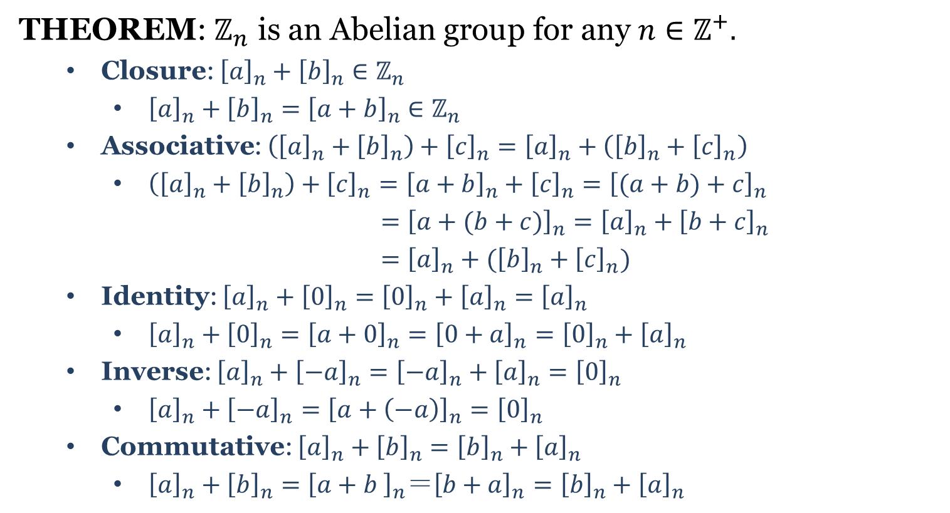

Group $ℤ_{n}$
THEOREM: $ℤ_{n}$ is an Abelian group for any $n∈ℤ^{+}.$
Closure: ${\left[a\right]}_{n}+{\left[b\right]}_{n}∈ℤ_{n}$
${\left[a\right]}_{n}+{\left[b\right]}_{n}={\left[a+b\right]}_{n}∈ℤ_{n}$
Associative: $\left({\left[a\right]}_{n}+{\left[b\right]}_{n}\right)+{\left[c\right]}_{n}={\left[a\right]}_{n}+\left({\left[b\right]}_{n}+{\left[c\right]}_{n}\right)$
$\left({\left[a\right]}_{n}+{\left[b\right]}_{n}\right)+{\left[c\right]}_{n}={\left[a+b\right]}_{n}+{\left[c\right]}_{n}={\left[(a+b)+c\right]}_{n}$
$={\left[a+(b+c)\right]}_{n}={\left[a\right]}_{n}+{\left[b+c\right]}_{n}$
$={\left[a\right]}_{n}+({\left[b\right]}_{n}+{\left[c\right]}_{n})$
Identity: ${\left[a\right]}_{n}+{\left[0\right]}_{n}={\left[0\right]}_{n}+{\left[a\right]}_{n}={\left[a\right]}_{n}$
${\left[a\right]}_{n}+{\left[0\right]}_{n}={\left[a+0\right]}_{n}={\left[0+a\right]}_{n}={\left[0\right]}_{n}+{\left[a\right]}_{n}$
Inverse: ${\left[a\right]}_{n}+{\left[−a\right]}_{n}={\left[−a\right]}_{n}+{\left[a\right]}_{n}={\left[0\right]}_{n}$
${\left[a\right]}_{n}+{\left[−a\right]}_{n}={\left[a+\left(−a\right)\right]}_{n}={\left[0\right]}_{n}$
Commutative: ${\left[a\right]}_{n}+{\left[b\right]}_{n}={\left[b\right]}_{n}+{\left[a\right]}_{n}$
${\left[a\right]}_{n}+{\left[b\right]}_{n}={\left[a+b \right]}_{n}＝{\left[b+a\right]}_{n}={\left[b\right]}_{n}+{\left[a\right]}_{n}$

Slide 13
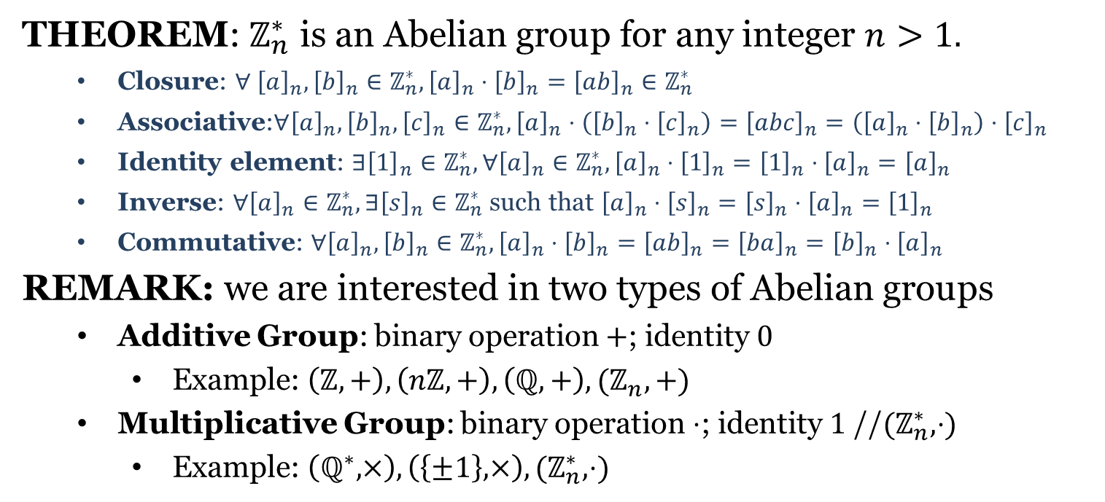

Group $ℤ_{n}^{∗}$
THEOREM: $ℤ_{n}^{∗}$ is an Abelian group for any integer $n>1.$
Closure: $∀ {\left[a\right]}_{n},{\left[b\right]}_{n}∈ℤ_{n}^{∗}, {\left[a\right]}_{n}⋅{\left[b\right]}_{n}={\left[ab\right]}_{n}∈ℤ_{n}^{∗}$
Associative:$∀{\left[a\right]}_{n},{\left[b\right]}_{n},{\left[c\right]}_{n}∈ℤ_{n}^{∗}, {\left[a\right]}_{n}⋅\left({\left[b\right]}_{n}⋅{\left[c\right]}_{n}\right)={\left[abc\right]}_{n}=\left({\left[a\right]}_{n}⋅{\left[b\right]}_{n}\right)⋅{\left[c\right]}_{n}$
Identity element: $∃{\left[1\right]}_{n}∈ℤ_{n}^{∗}, ∀{\left[a\right]}_{n}∈ℤ_{n}^{∗}, {\left[a\right]}_{n}⋅{\left[1\right]}_{n}={\left[1\right]}_{n}⋅{\left[a\right]}_{n}={\left[a\right]}_{n}$
Inverse: $∀{\left[a\right]}_{n}∈ℤ_{n}^{∗},∃{\left[s\right]}_{n}∈ℤ_{n}^{∗}$ such that ${\left[a\right]}_{n}⋅{\left[s\right]}_{n}={\left[s\right]}_{n}⋅{\left[a\right]}_{n}={\left[1\right]}_{n}$
Commutative: $∀{\left[a\right]}_{n}, {\left[b\right]}_{n}∈ℤ_{n}^{∗}, {\left[a\right]}_{n}⋅{\left[b\right]}_{n}={\left[ab\right]}_{n}={\left[ba\right]}_{n}={\left[b\right]}_{n}⋅{\left[a\right]}_{n}$
REMARK: we are interested in two types of Abelian groups
Additive Group: binary operation $+$; identity $0$
Example: $\left(ℤ,+\right), \left(nℤ, +\right), \left(ℚ,+\right), (ℤ_{n},+)$
Multiplicative Group: binary operation $⋅$; identity $1$ //${(ℤ}_{n}^{∗},⋅)$
Example: $\left(ℚ^{∗}, ×\right),\left(\left\{±1\right\}, ×\right), (ℤ_{n}^{∗},⋅)$

